Slide 1
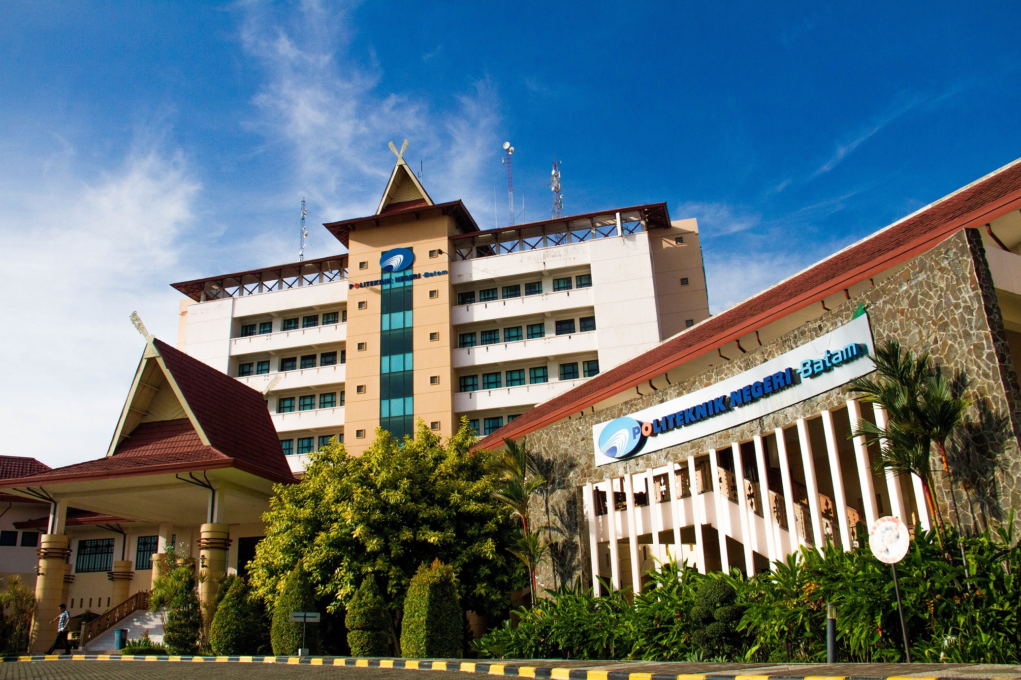

Politeknik
Negeri Batam
Python – Introduction and Data Types
Week 2
D4 Robotics Engineering Study Program
Department of Electrical Engineering
Politeknik Negeri Batam
Presented by : Naurah Nazhifah, S.Kom., M.C.S(AI).

Slide 2

Course Learning Outcome
Students are able to explain the comparison of Python with other programming languages
Students are able to create simple programs with Python with a python programming editor/platform
Students are able to express the differences between primitive data types and non-primitive data types
Students are able to explain the differences between list, tuple, dictionary, and set data types
Students are able to perform data conversion

Slide 3
Table of
Contents
01
Python Language
02
Python Programming Platform
03
Python Data Types
04
Data Type Conversion
05
Closing

Slide 4
Python
01
Language

Slide 5
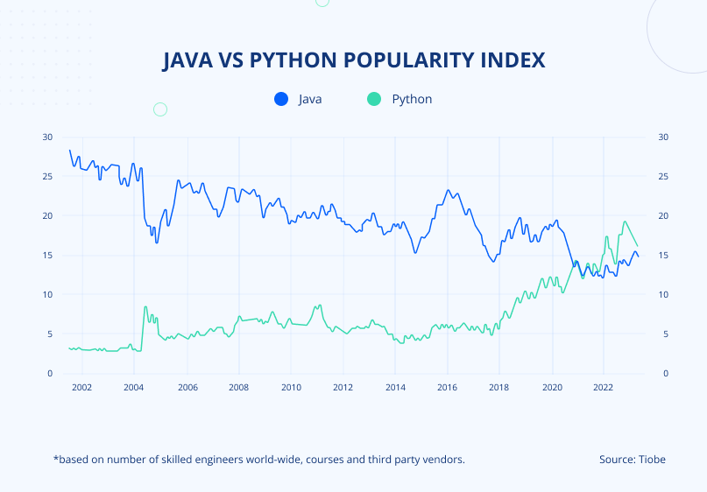
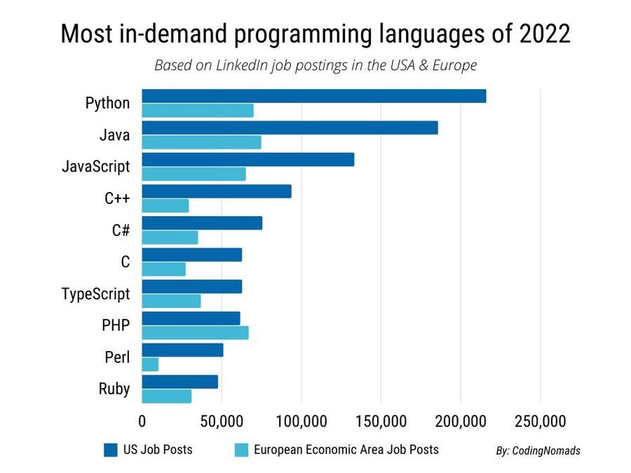
What is Python?
Python is a dynamic, open-source programming language that emphasizes simplicity and productivity. Python has a natural, elegant syntax and is easy to read/write.

Slide 6
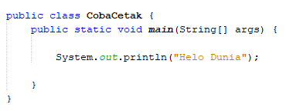
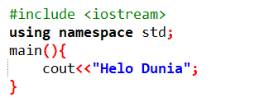
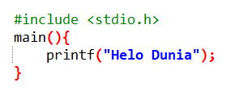
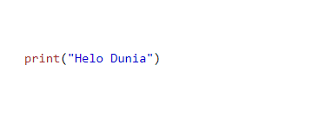
Python language comparison
Java
C++
C
Python

Slide 7
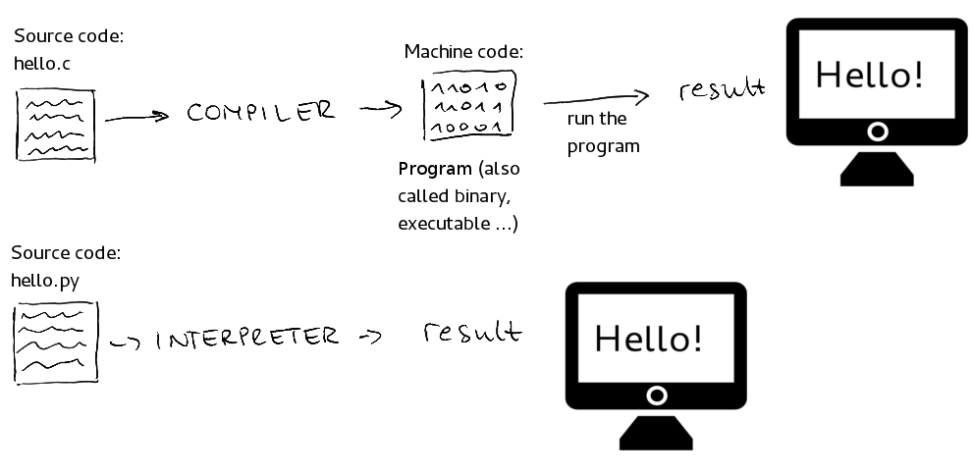
2. How Does Python Work?

Slide 8
2. How Does Python Work?
Aspect | Interpreter | Compiler
Execution Method | Executes code line by line | Translates the entire code first, then runs it
Speed | Slower (because it translates while running) | Faster (since it's already translated)
Error Handling | Stops immediately when an error is found | Finds all errors at once after compiling
Flexibility | More flexible; easier to test and debug | Less flexible; needs recompilation after every change

Slide 9






3. Applications That Can Be Developed with Python
Web Development
Data Scince and Analysis
Web Scraping
Game Development
Software testing
Cybersecurity

Slide 10
Python
02
Programming Platform

Slide 11
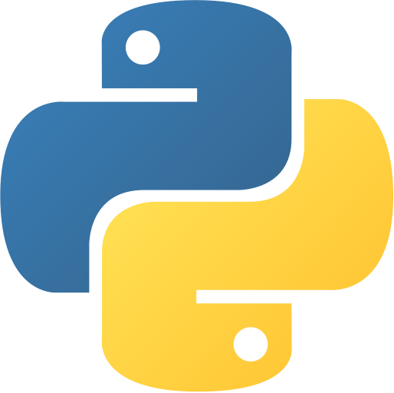
Programming Platform
There are 4 popular editors/platforms that can be used to write and run Python programs, including:
Terminal
Terminal & Text Editor
IDE
IDE for research and development

Slide 12
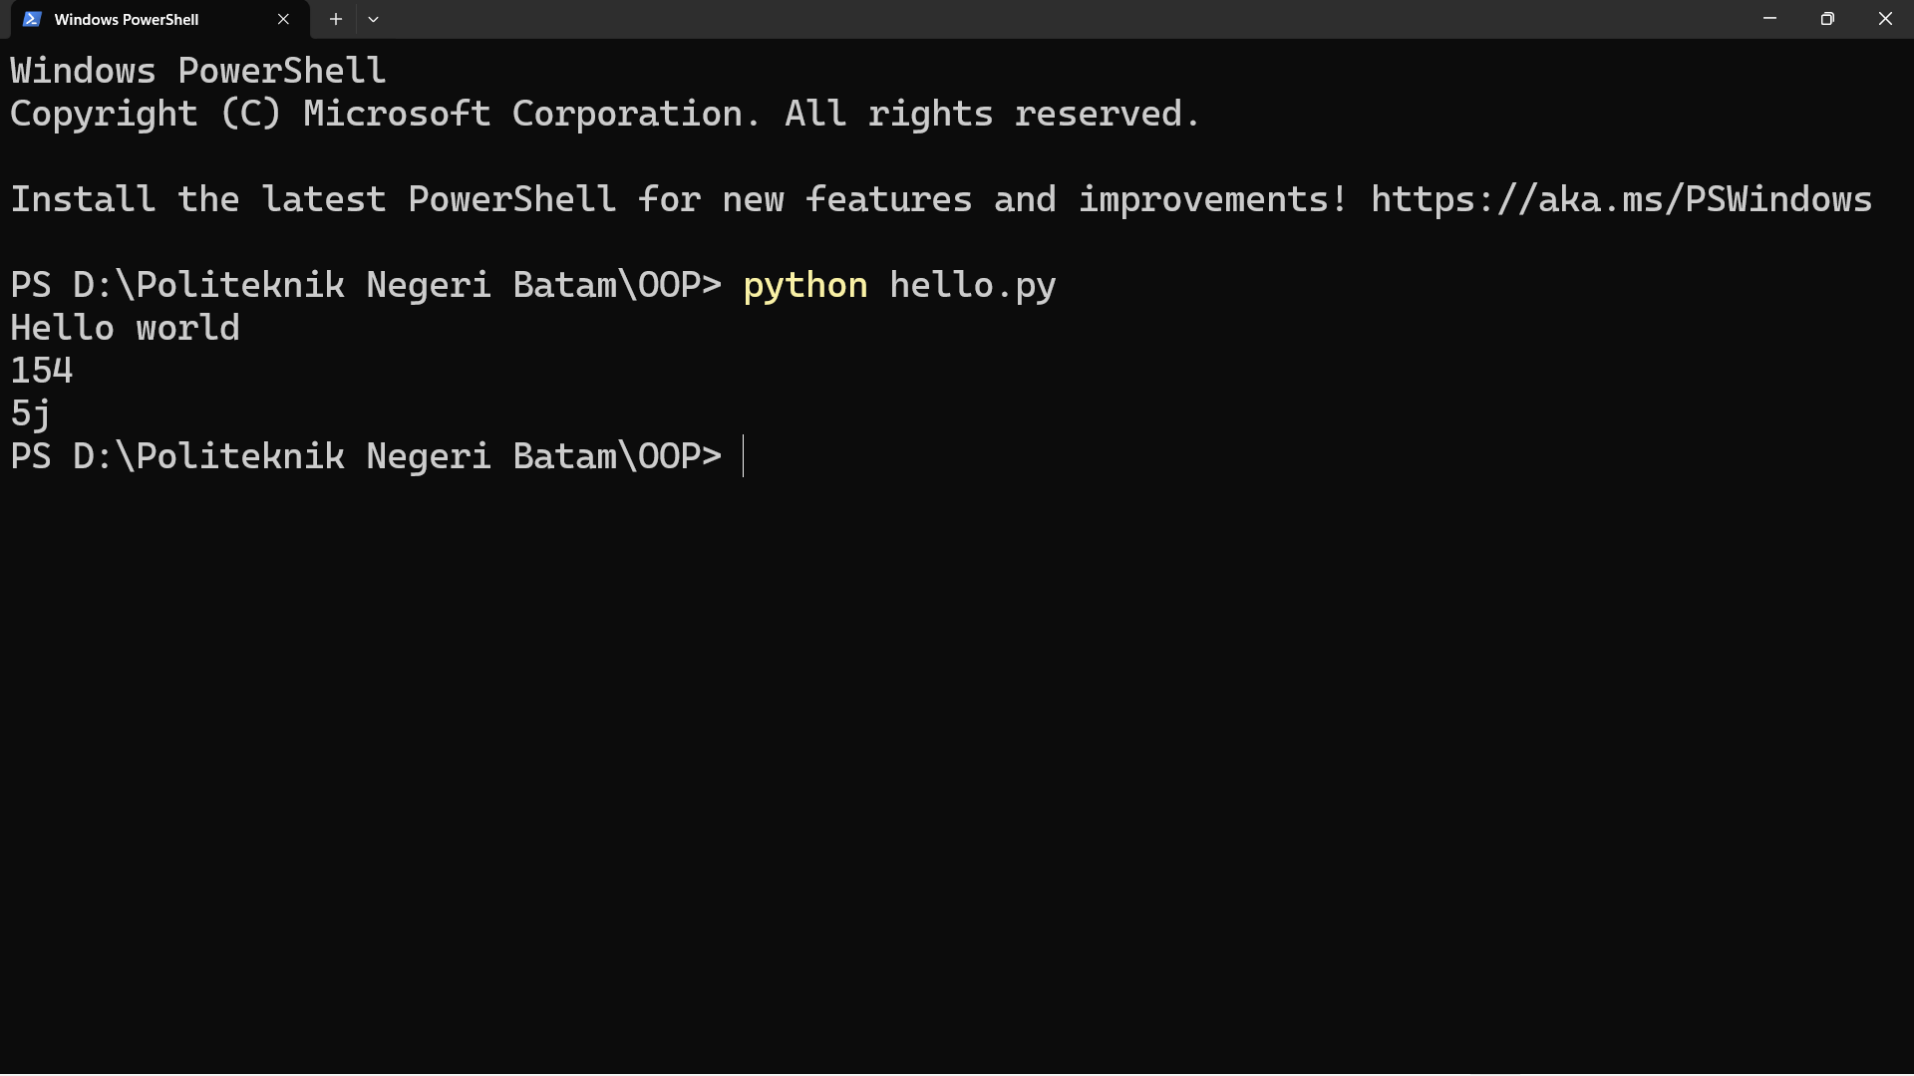
Terminal

Slide 13
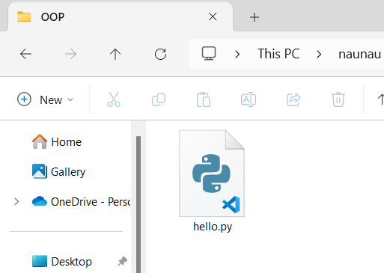
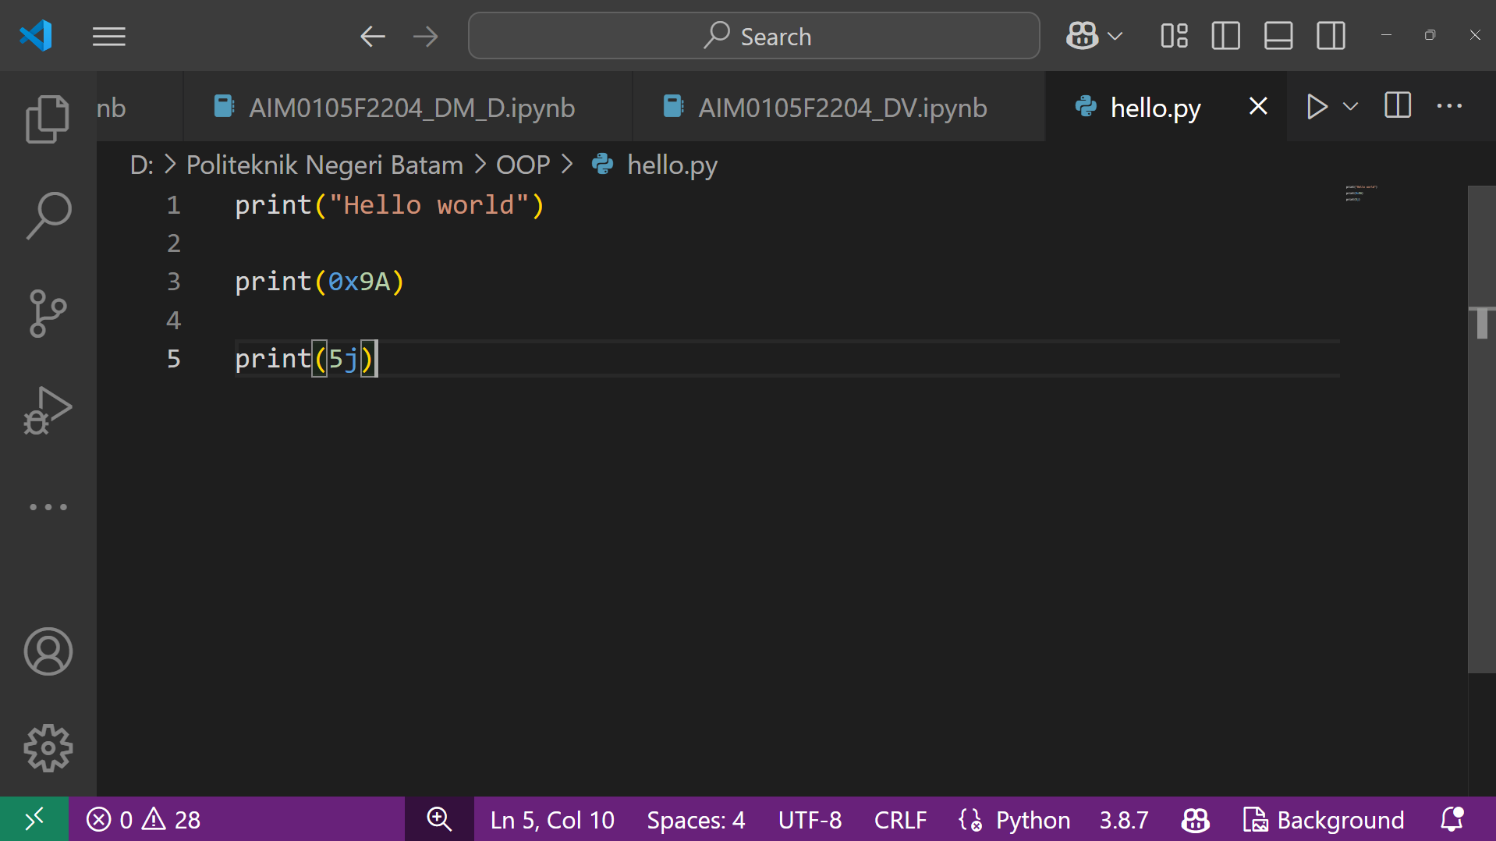
2. Terminal + Text Editor
1
2

Slide 14
3. Python IDEs
Python IDEs (Integrated Development Environments) are software that provide a complete environment for writing, editing, running, and debugging Python code.
IDEs usually come with features like:
✅ Code editor with syntax highlighting
✅ Debugger to find and fix errors
✅ Project management to manage files and dependencies
✅ Built-in terminal to run scripts directly

Slide 15
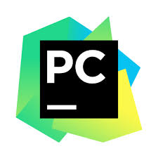



3. Python IDEs
IDE | Description
PyCharm | Advanced IDE with full features for Python and Django development
VsCode | Lightweight editor with powerful Python extensions
Jupyter Notebook | Web-based IDE for data analysis and machine learning
Spyder | IDE specifically for data science and scientific computing

Slide 16
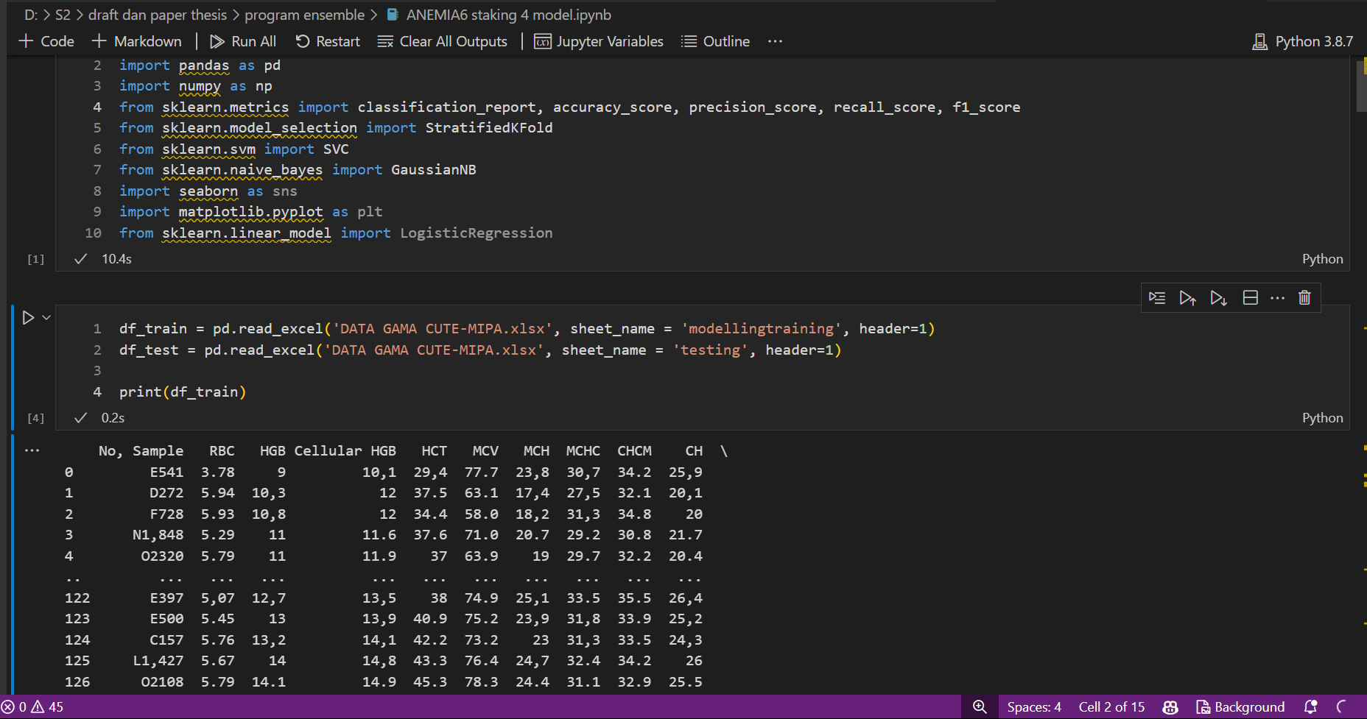
4. IDE for Research and Development

Slide 17
What is Visual Studio Code?
Visual Studio Code (abbreviated VSCode) is a source code editing software made by Microsoft for Linux, macOS, and Windows.
Visual Studio Code is a source code editor that can be used for a variety of programming languages, including C#, HTML, CSS, Java, JavaScript, Node.js, Python, PHP and C++.

Slide 18
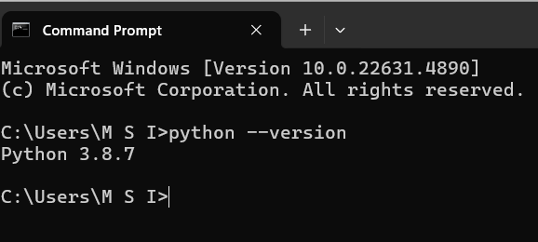
Setting up VsCode for Python
1. Install Vs Code & Python
Download & install VS Code → https://code.visualstudio.com/
Install Python (jika belum ada) → https://www.python.org/downloads/
Pastikan Python sudah terinstall dengan mengetik di terminal:

Slide 19
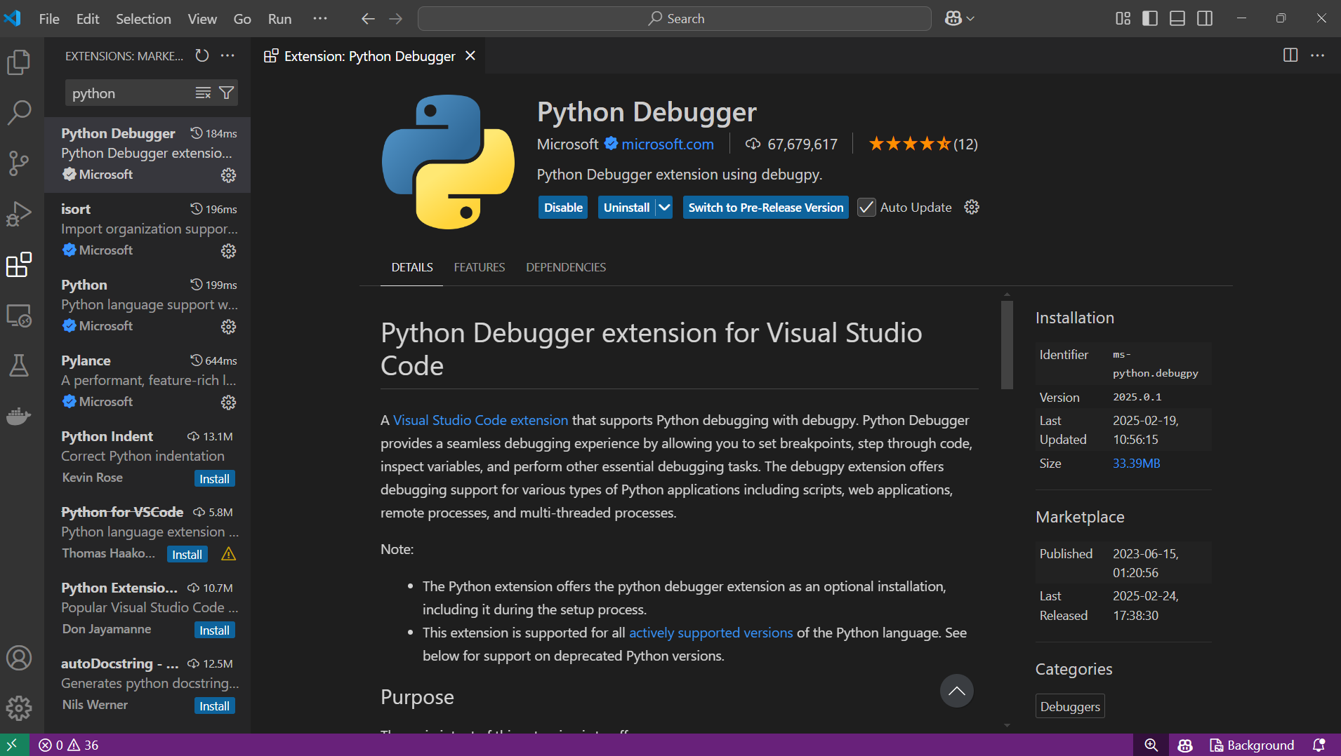
Setting up VsCode for Python
2. Install Python Extension in VsCode
Open VS Code
Go to Extensions (Ctrl + Shift + X or Cmd + Shift + X on Mac)
Search for Python (from Microsoft) and click Install
Once installed, make sure the extension is active

Slide 20
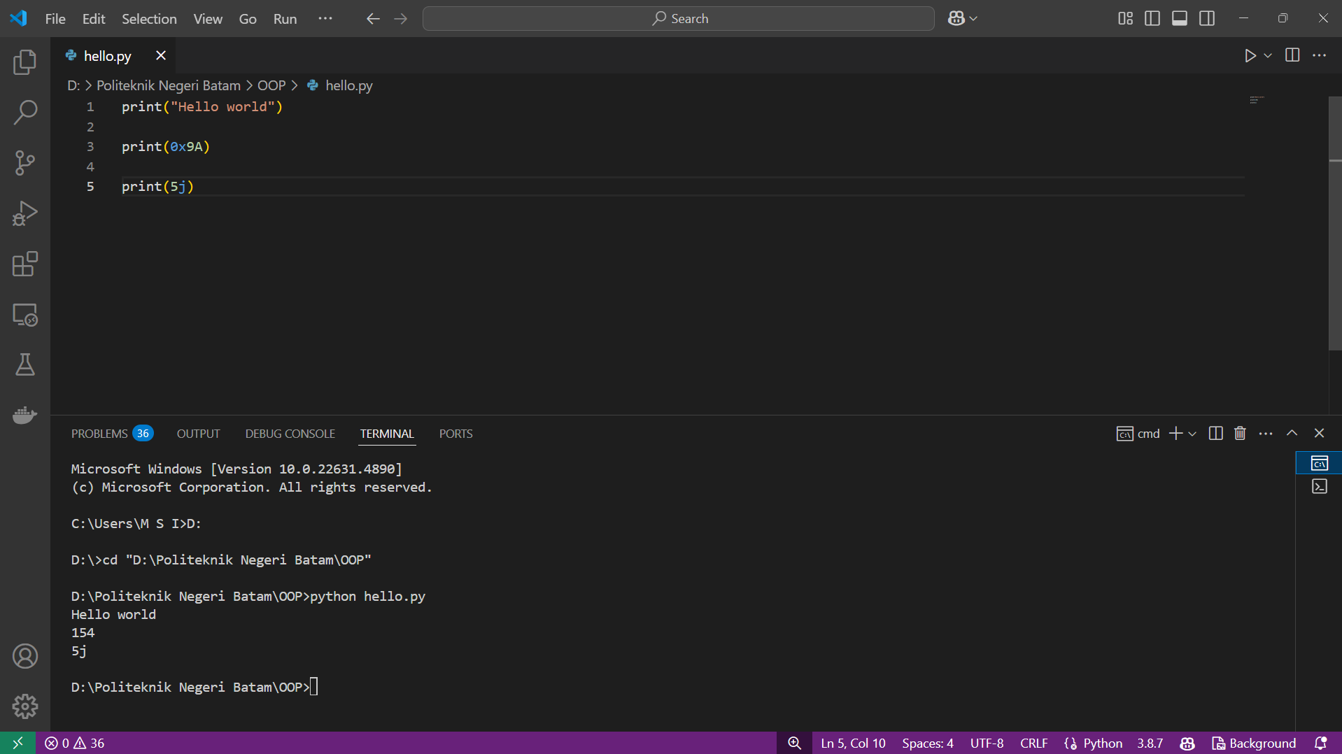
Programming in Python

Slide 21
Python
03
Data Types
You can open this colab:
https://colab.research.google.com/drive/1kR5aArRY6u577woE87JLszC6e4IxqGw4?usp=sharing

Slide 22


Data Structures in Python
In Python, there are several built-in data structures that are frequently used to store and manage data.
Primitive Data Types
Non-Primitive Data Types

Slide 23
Primitive Data Types
Primitive Data Types
Numbers
String
Boolean
Integer
Float
Complex

Slide 24
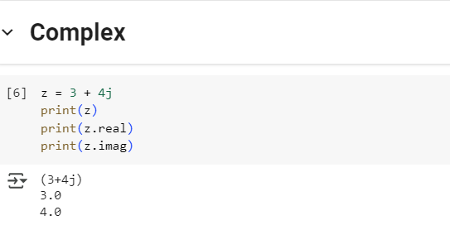
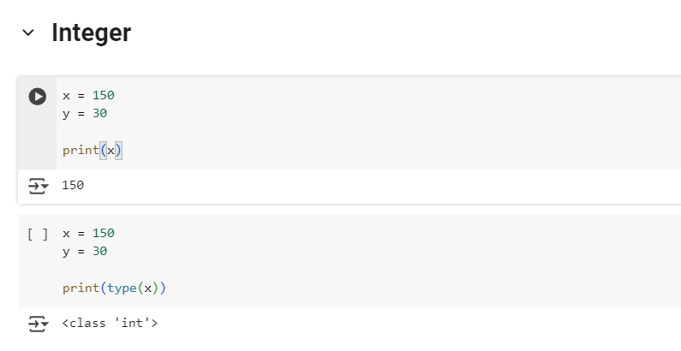
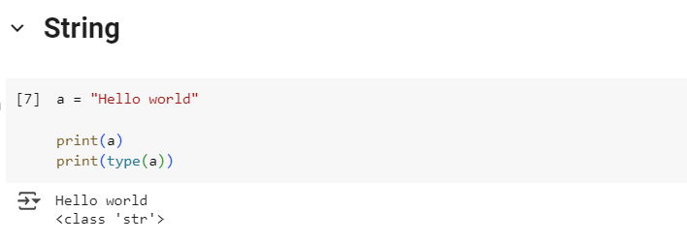
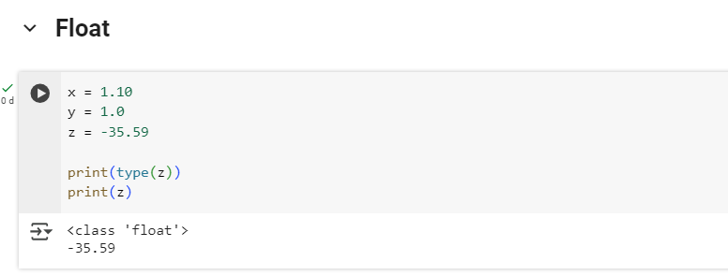
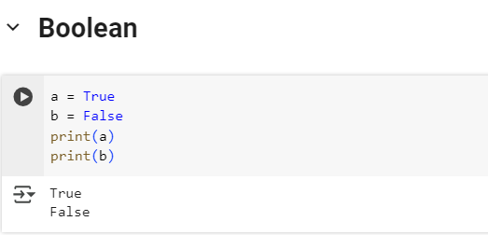
Primitive Data Types

Slide 25
Non-Primitive Data Types
Non-Primitive Data Types
List
Tupple
Dictionary
Set
List, dictionary, and set data types are mutable data types, while tuple data types are immutable.

Slide 26
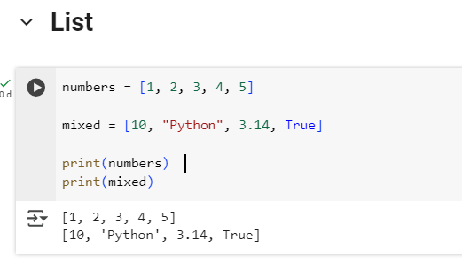
Non-Primitive Data Types
1. List
Values ​​stored in a list can be accessed using the slice operators ( [ ] and [ : ] ) with indices starting at 0 at the beginning of the list. Indexing starts at 0 (left to right).

Slide 27
Non-Primitive Data Types
List
Methods on List
list.append(elemen)
list.insert(index, elemen)
list.extend(list2)
list.index(elemen)
list.remove(elemen)
list.sort()
list.reverse()
list.pop(index)

Slide 28
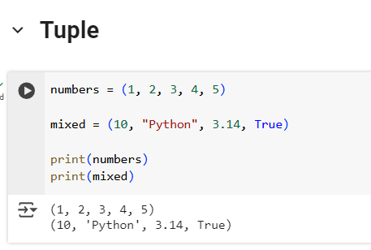
Non-Primitive Data Types
2. Tuple
Tuples contain items separated by commas and enclosed in parentheses (()).
Values ​​stored in tuples can be accessed using the slice operators ( [ ] and [: ] ) with indices starting at 0 at the beginning of the tuple.

Slide 29
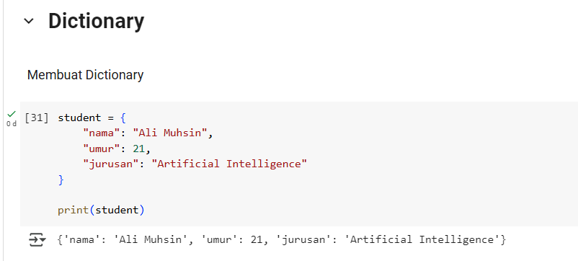
Non-Primitive Data Types
3. Dictionary
A dictionary contains items separated by commas and enclosed in curly brackets ({}).
Each item has two components – key and value.
Key identifies an item, and value stores the value of the item. Values ​​can be accessed by passing the key in square brackets ([]).

Slide 30
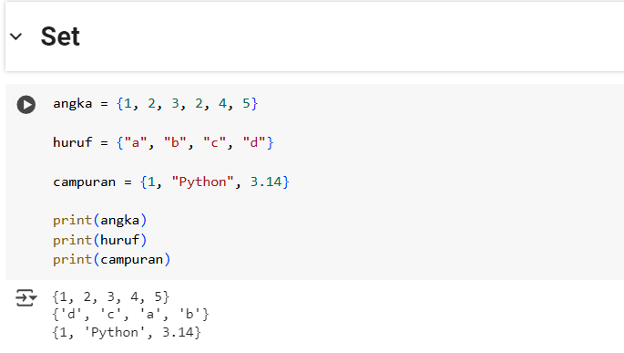
Non-Primitive Data Types
4. Set
A set is a collection of values ​​separated by commas and enclosed in curly brackets ({}).
The set data type is irregular, mutable and does not support repetition of elements.

Slide 31
Python
04
Data Type Conversion

Slide 32
Data Type Conversion
Data type conversion means changing one data type to another.
Python provides two types of conversion:
Implicit Conversion → Python automatically changes the data type.
Explicit Conversion/Casting → We have to use a specific function to convert data types.

Slide 33
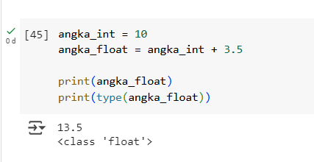
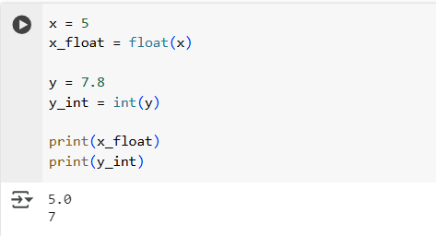
Implicit Conversion
Python automatically converts data types without losing information.
Explicit Conversion
We can change data types with Python's built-in functions.

Slide 34
Next Topic: Data Exploration and Data Visualization

Slide 35
Reference
https://docs.python.org/3/tutorial/index.html

Slide 36
THANK YOU!

